Slide 1
ETS Decomposition
Renato R. Maaliw III, DIT
College of Engineering
Southern Luzon State University
Lucban, Quezon, Philippines

Slide 2
ETS
stands for Error, Trend, and Seasonality
a method used to break down a time series into three components

Slide 3
Trend (T)
Overall direction in which the time series is moving (upward, downward, stable/flat)

Slide 4
Seasonality (S)
Repeating patterns in the series (e.g. daily, monthly, yearly)

Slide 5
Residual/Error (E)
The noise or irregular fluctuations that cannot be explained by trend or seasonality

Slide 6
ETS decomposition allows us to understand the underlying patterns in a time series and helps in forecasting

Slide 7
Types of ETS Models
Additive Model
- when seasonal variations remain constant
over time

Slide 8
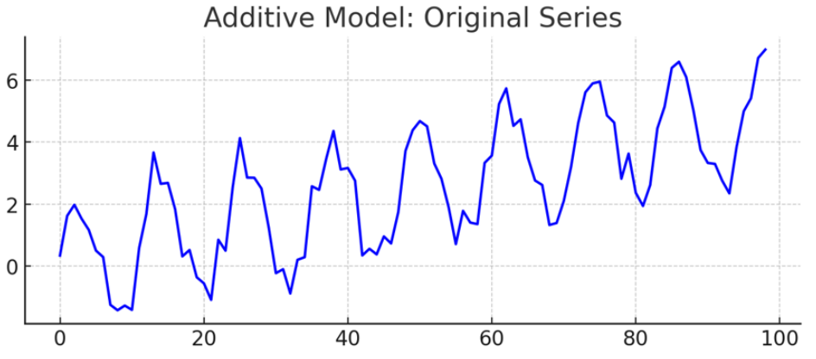

Slide 9
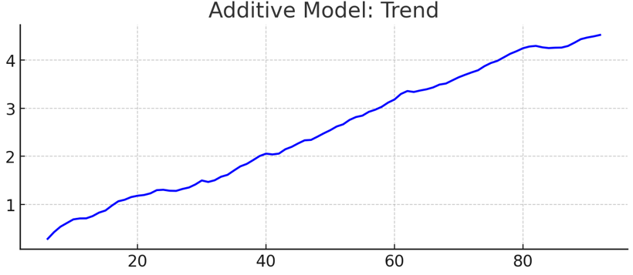
Additive Model’s trend increase linearly over time

Slide 10
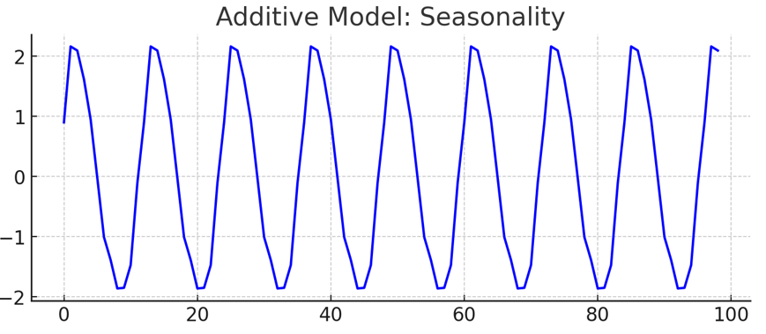
Additive Model’s seasonal pattern remains constant in magnitude
(fixed oscillations)

Slide 11
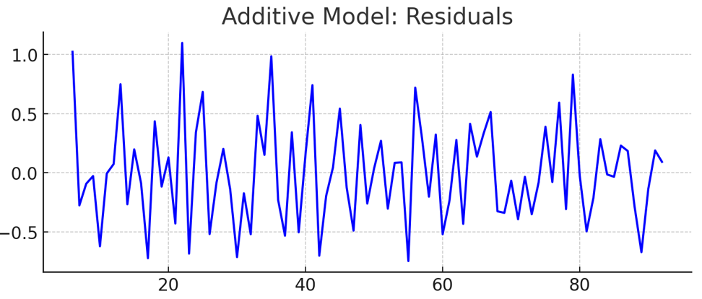
Additive Model’s residuals have constant noise over time

Slide 12
Types of ETS Models
2. Multiplicative Model
- when seasonal variations increase or
decrease in size over time

Slide 13
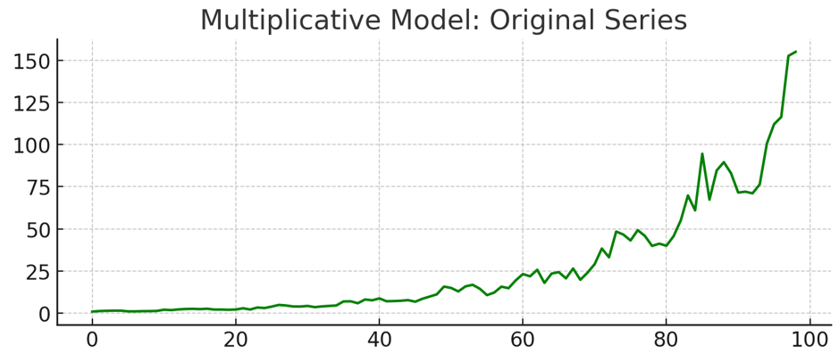

Slide 14
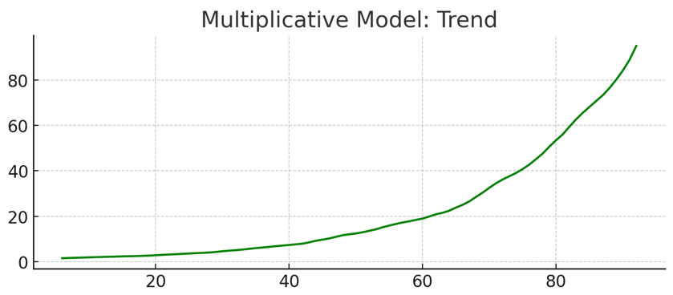
Multiplicative Model’s trend grows exponentially

Slide 15
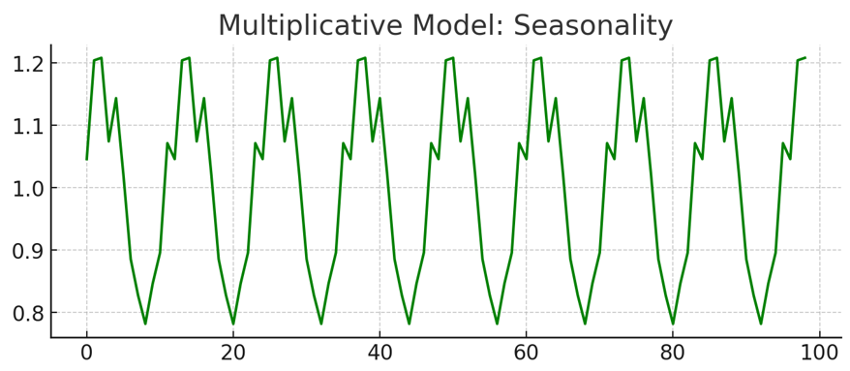
Multiplicative Model’s seasonal pattern increases in magnitude over time
(amplitude grows larger)

Slide 16
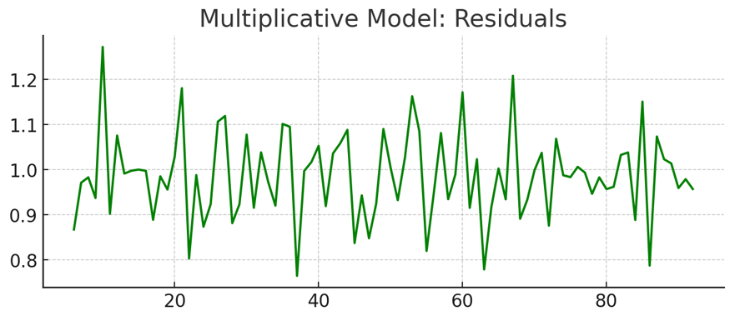
Multiplicative Model’s residuals noise grows larger as the series increases

Slide 17
[Code Demo]

Slide 18
Thank you very much for listening.

